Slide 1
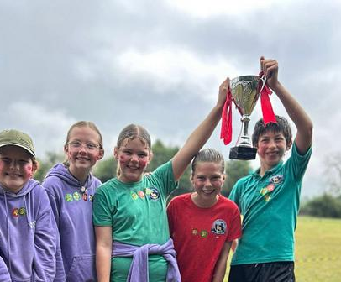

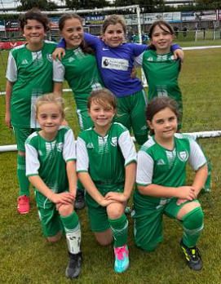
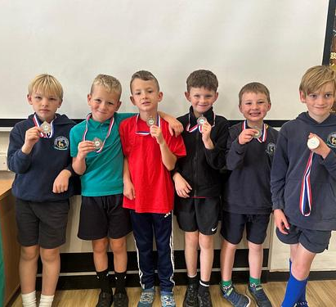
PE and Sport Premium
Monitoring and Tracking
2025/2026

Slide 2

PE and sport premium monitoring and tracking form
At Staindrop C E Primary School, we believe passionately in the value of high quality physical education, opportunities for school sports and participation in physical activity (PESSPA). Each has an enormous impact on health and emotional well-being as well as significantly impacting on whole school improvement.
We want to provide opportunities for our pupils to become confident and physically literate in a way which supports their well-being, health and fitness. In addition to this, we aim to provide opportunities for children to succeed and excel in competitive sport and other physically demanding activities in order to build resilience and embed values such as team work, fairness and respect.
At Staindrop, we use the PE and sport premium to secure improvements in the following 5 key indicators:
Increased confidence, knowledge and skills of all staff in teaching PE and sport
Engagement of all pupils in regular physical activity
The profile of PE and sport is raised across the school as a tool for whole-school improvement
Broader experience of a range of sports and physical activities offered to all pupils
Increased participation in competitive sport

Slide 3

Review of the last academic year (2024/2025)
SWIMMING
Swimming is an essential skill and can encourage a healthy and active lifestyle. All Local Authority schools must provide swimming instruction in either key stage 1 or key stage 2.
The programme of study for PE sets out the expectations that pupils should be taught to:
Swim competently, confidently and proficiently over a distance of at least 25 meters.
Use a range of strokes effectively (for example, front crawl, backstroke and breast stroke)
Perform safe self-rescue in different water-based situations.
Year 6 leaving at the end of the academic year 2024/25 is as follows:
.
Swimming and Water Safety | Percentage to achieve the expectation:
1. Swim competently, confidently and proficiently over a distance of at least 25 metres | 90%
2. Use a range of strokes effectively (for example, front crawl, backstroke and breaststroke) | 90%
3. Perform safe self-rescue in different water-based situations | 81%
KS2 Swimming Gala was also attended where we won 3 golds and a silver!
Year 4 will swim this year along with Year 6 pupils that need catch up.

Slide 4
Objective: Increase all staff’s confidence, knowledge and skills in teaching PE and sport.
 | Intent - what is your objective? | Implementation - How will you achieve this? | Impact - What do you hope to see? | Supporting evidence
Plan and monitor (Complete now and monitor) | Ensure all staff are 100% confident in teaching our PE curriculum. Create a robust CPD programme. | PE lead to deliver Staff meetings on the Get Set 4 PE scheme and plans to support staff in delivering the scheme. Teachers to attend appropriate CPD to increase confidence. Ensure a robust CPD programme is created. Sprots coaches to team teach with staff to build confidence. | Competent and confident staff. Enhanced quality of teaching and learning. Improved standards and expectations. Good progression in P.E. Improved pupil attitude to P.E.. | Learning walks. Staff/ pupil voice. Pupils making expected progress in PE and data rising.
 | What impact have you seen? | Are the improvements sustainable? How? | Supporting evidence | Approx. cost
Evaluate (Complete in July) |  |  |  | £450- Get Set 4 PE subscription £3,500- CPD £950- update resources Total = £4,900

Slide 5
Objective: Increase engagement of all pupils in regular physical activity and sport.
 | Intent - what is your objective? | Implementation - How will you achieve this? | Impact - What do you hope to see? | Supporting evidence
Plan and monitor (Complete now and monitor) | To ensure children are assessed accurately across the PE Curriculum. Children to be active for a minimum of 60minutes a day. Identify what activities children do outside of school. Encourage children to travel to and from school in an active way. | Develop a monitoring programme to assist with PE assessment, identifying pupils’ strengths and areas for development. Identify how active pupils are throughout the day using the “Moki Bands” Introduce a 10-minute active session each day (Joe Wicks- Activate BBC) Pupil surveys of travel to school. Introduce, “Walk to School Weeks”. | We will be able to identify less active children and help provide more focused support. See that every pupil records 60 active minutes a day on their watch. Children engaged and enjoying active blasts. Pupils will walk/ scooter/ bike to and from school and therefore be more active. | Assessments Moki data Transport surveys Photos/ social media
 | What impact have you seen? | Are the improvements sustainable? How? | Supporting evidence | Approx. cost
Evaluate (Complete in July) |  |  |  | £900 Moki Bands £200 Monitoring Programme Total- £1,800

Slide 6
Objective: Raise the profile of PE and Sport across the school.
 | Intent - what is your objective? | Implementation - How will you achieve this? | Impact - What do you hope to see? | Supporting evidence
Plan and monitor (Complete now and monitor) | Create a link in understanding of physical activity for our health and wellbeing, with teaching and learning across the health education curriculum taught as part of relationships, sex and health education (RSHE) and PSHE. Develop Sports Leaders further to help offer more sports to children. Create a Sports ambassador role within the Pupil Council. Raise further awareness of PE and Sport to parents and Governing Board. | Work with RSHE and PSHE Leads to create cross-curricular links. Seek pupil voice about the types of activity that they enjoy and question why they think physical activity is important. Children to create sports stations at playtime and lunchtime. Further enhance our OPAL playtimes. Sports ambassador within the pupil council to raise areas within PE and sport. Appoint a member of staff as a Sports Coordinator to discuss Primary PE and sport premium with stakeholders more regularly for example: speaking at parent forums or Governing Board Committee Meetings. | Build children’s resilience, confidence and the ability to work with others. Children enjoy playtime and are active throughout. Improved behavior at playtimes. Advice/ support from parents and governors will raise the profile of PE and Sport further. | Planning Pupil Voice Meeting minutes Sports newsletter Learning walks
 | What impact have you seen? | Are the improvements sustainable? How? | Supporting evidence | Approx. cost
Evaluate (Complete in July) |  |  |  | £500 update playtime equipment £3,870- Sports Coordinator Total: £6,370

Slide 7
Objective: Offer a broader and more equal experience of a range of sports and physical activity to all pupils.
 | Intent - what is your objective? | Implementation - How will you achieve this? | Impact - What do you hope to see? | Supporting evidence
Plan and monitor (Complete now and monitor) | Ensure there is coverage of multiple invasion games, striking and fielding games, net/wall games, athletics, gymnastics and dance as well as outdoor adventure activity and swimming and water safety. Offer the children a balanced and varied extra-curricular programme. Provide additional sporting opportunities for SEND and less able children. | Get Set 4 PE planning tool to ensure a good coverage to sports. Staindrop SLA provide coaching to all year groups. Year 4 swimming. Year 6 children to attend catch up swimming lessons. Employment of sports coaches to provide after school clubs. SEND children to attend specialist events (Nerf Wars/ Mental Wellbeing day @ TCR Hub). Additional support during PE lessons from trained LSAs. | Every year group to participate in a team and individual sport. Children confident across a range of sports. All children can swim 25m when leaving in Year 6. Build and develop active links and clear pathways to sport, physical activity and leisure providers in the local community, SEND children to have the same opportunities within PE. All children understand the benefit of exercise and children experience alternative/ more accessible sports. | Planning Assessment Increase in sports club attendance. Links with local clubs. PE newsletter.
 | What impact have you seen? | Are the improvements sustainable? How? | Supporting evidence | Approx. cost
Evaluate (Complete in July) |  |  |  | £2,750- SLA agreement £1,000- Top up swimming and transport £1,000- LSA support Total- £4750

Slide 8
Objective: Increase participation in competitive sports.
 | Intent - what is your objective? | Implementation - How will you achieve this? | Impact - What do you hope to see? | Supporting evidence
Plan and monitor (Complete now and monitor) | Create a calendar that demonstrates opportunities for all young people regardless of sex, educational need or other targeted groups. Provide opportunities for all children to challenge themselves through both intra and inter school sport, where the. | Sports Lead to work with SLA/ School Sports/ local clubs etc to create a broad range of competitions. SLA agreement to provide competitions. Lewis Marrs competitions and football tournaments. 3 intra-school competitions to be held per year. ‘Monster Kickabout”, Sports Day and one other sport of choice | The calendar will showcase the various competitions that children will take part in. Children will get excited about events (like they already do with cross country, swimming gala etc) Children's motivation, competence and confidence are at the centre of the competition and the focus is on the experience rather than the outcome. | Sport Calendar Results from competitions Sports newsletter. Social media
 | What impact have you seen? | Are the improvements sustainable? How? | Supporting evidence | Approx. cost
Evaluate (Complete in July) |  |  |  | £1,600 School Sports competitions and football tournaments. £500 resources for intra-school events Total: £2,100

